Slide 1
Circular Linked List

Slide 2
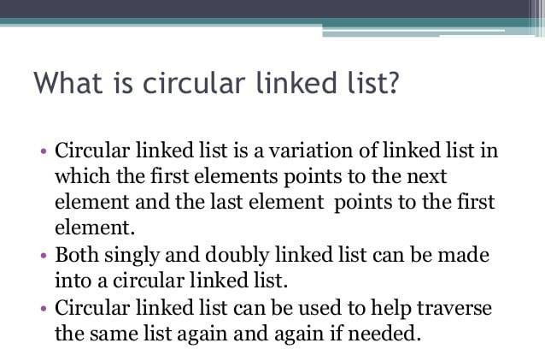

Slide 3
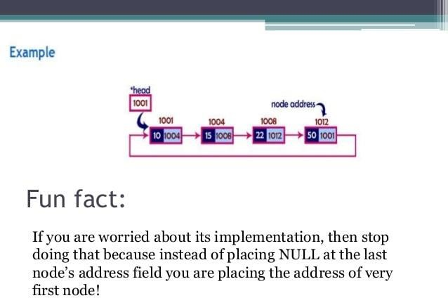

Slide 4
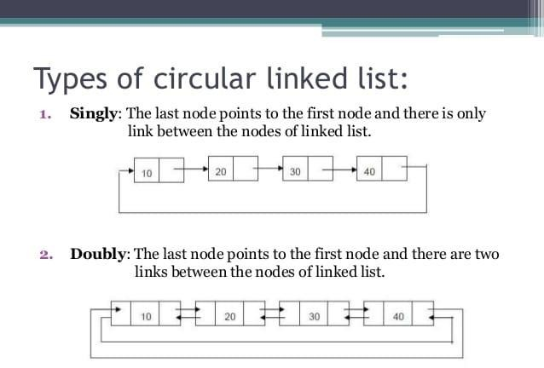

Slide 5
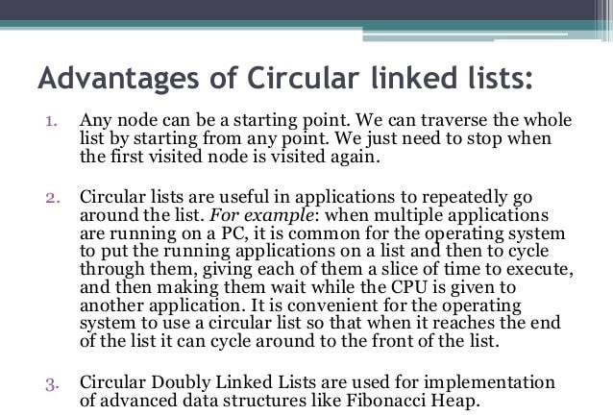

Slide 6
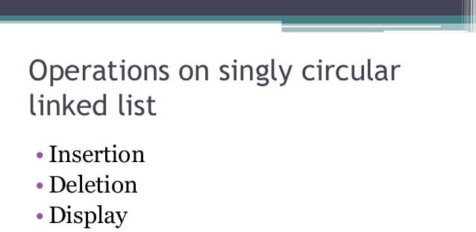

Slide 7
//This function will add the new node at the end of the list.
void add(int data){
//Create new node
struct node *newNode = (struct node*)malloc(sizeof(struct node));
newNode->data = data;
//Checks if the list is empty.
if(head == NULL){
//If list is empty, both head and tail would point to new node.
head = newNode;
tail = newNode;
newNode->next = head;
}else {
//tail will point to new node.
tail->next = newNode;
//New node will become new tail.
tail = newNode;
//Since, it is circular linked list tail will point to head.
tail->next = head;
19. } 20.}

Slide 8
//This function will display the nodes of circular linked list
void display(){
struct node *current = head;
if(head == NULL){
printf("List is empty");
. }
else{
printf("Nodes of the circular linked list: \n");
do{
//Prints each node by incrementing pointer.
printf("%d ", current->data);
current = current->next;
}while(current != head);
printf("\n");
15. } 16.}

Slide 9
Doubly Linked List
A doubly linked list or a two way linked list is a more complex type of linked list which contains a pointer to the next as well as previous node in the sequence.
Therefore, it consists of three parts and not just two. The three parts are data, a pointer to the next node and a pointer to the previous node
START
X
1
1
2
3
4 X
© Oxford University Press 2014. All rights reserved.

Slide 10
Doubly Linked List
In C language, the structure of a doubly linked list is given as,
struct node
{
struct node *prev; int data;
struct node *next;
};
The prev field of the first node and the next field of the last node will contain NULL. The prev field is used to store the address of the preceding node. This would enable to traverse the list in the backward direction as well.
© Oxford University Press 2014. All rights reserved.

Slide 11
Operations
1.Traversal of a Doubly linked list
Insertion of a node:
At the beginning: The new created node is insert in before the head node and head points to the new node.
At the end: The new created node is insert at the end of the list and tail points to the new node.
At a given position: Traverse the given DLL to that position(let the node be X)
Deletion of a node:
At the beginning: Move head to the next node to delete the node at the beginning and
make previous pointer of current head to NULL .
At the last: Move tail to the previous node to delete the node at the end and make next pointer of tail node to NULL.
At a given position:

Slide 12
Doubly Linked List
Algorithm to insert a new node in the beginning of
the doubly linked list
Step Step | 1: 2: | SET SET | New_Node->DATA = New_Node->PREV = | VAL NULL
Step | 3: | SET | New_Node->Next = | START
Step | 4: | SET | START = New_Node
Step | 5: | EXIT
X 1 7
3
4
2 X
START
X 9 1
7
3
4
2 X
START
© Oxford University Press 2014. All rights reserved.

Slide 13
Doubly Linked List
Algorithm to insert a new node at the end of the doubly
linked list
Step 1: SET New_Node->DATA = VAL Step 2: SET New_Node->Next = NULL Step 3: SET PTR = START
Step 4: Repeat Step 4 while PTR->NEXT != NULL Step 5: SET PTR = PTR->NEXT
[END OF LOOP]
Step 6: SET PTR->NEXT = New_Node Step 7: New_Node->PREV = PTR Step 8: EXIT
X 1 7
3
4
2 X
START, PTR
X 1 7 3 4 2
© Oxford University Press 2014. All rights reserved^{PT}.^{R}
9
X

Slide 14
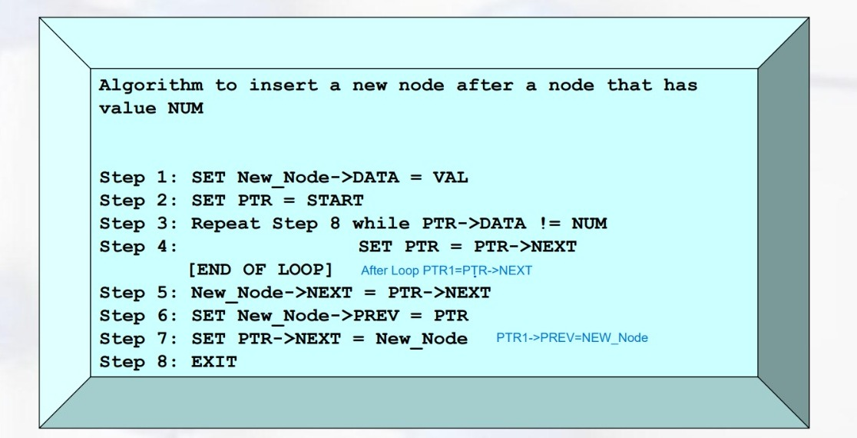

Slide 15
